Slide 1

BUMN LEMBAGA PELAKU EKONOMI NEGARA DAN POLITIK EKONOMI INKLUSIF MELALUI BUMR
The Sultan Hotel, 12th December 2018

Slide 2
PELAKU EKONOMI PANCASILA SESUAI UUD 45

Slide 3
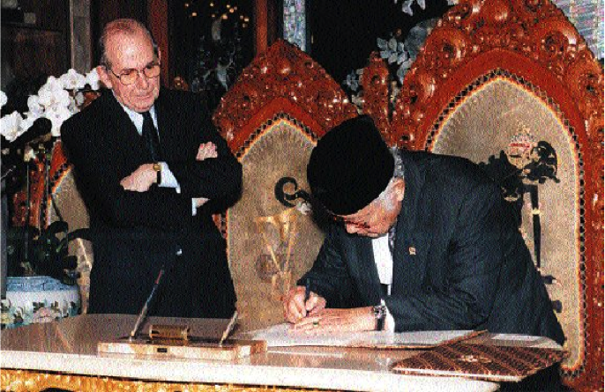
Signing LoI with IMF

Slide 4
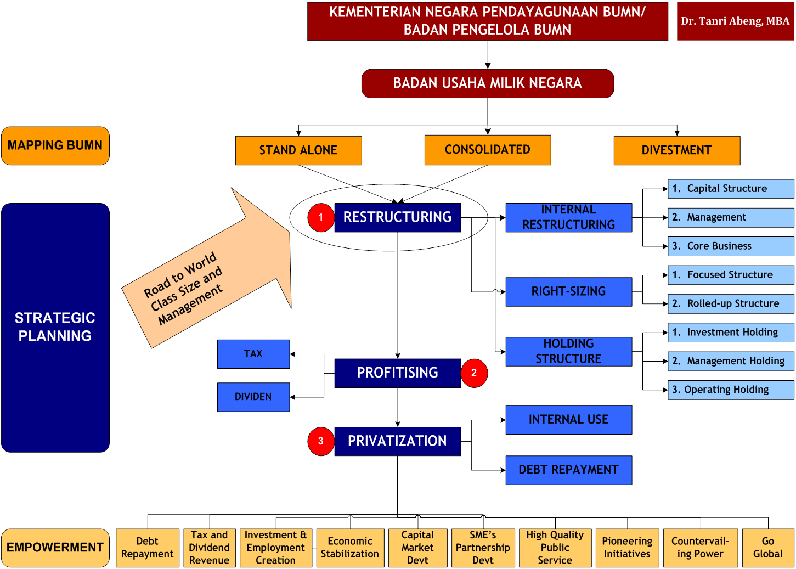
Strategy,
System & Scale

Slide 5
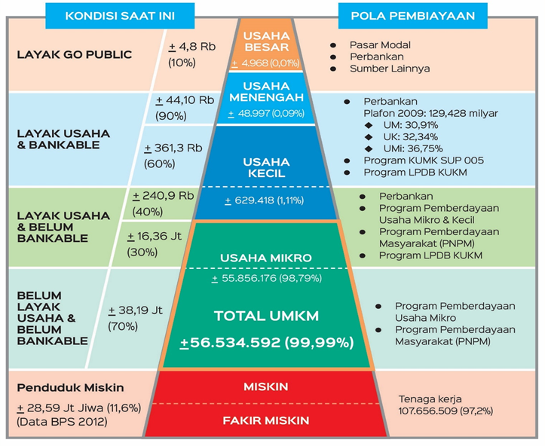
Sasaran
PEMERATAAN EKONOMI
Total Tenaga Kerja 107.657.509
Sumber: Kemenkop UKM (data tahun 2012)

Slide 6

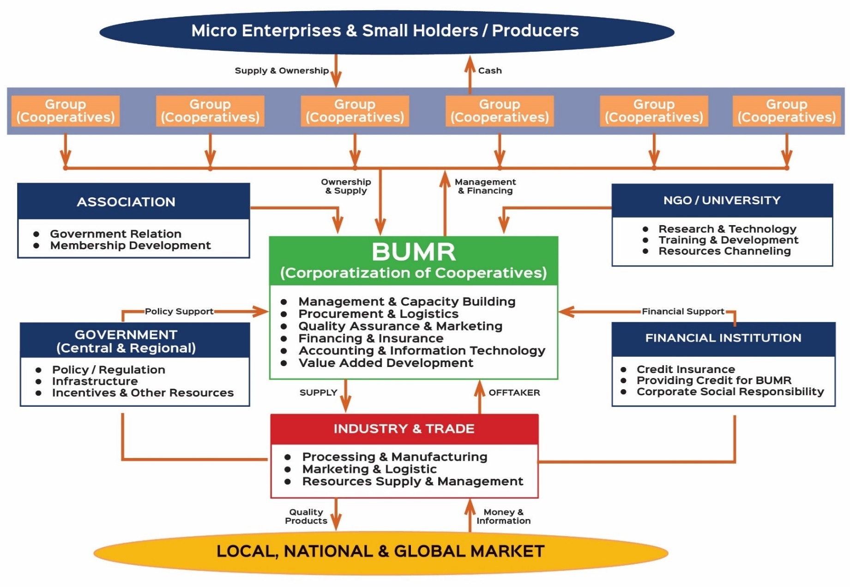

Slide 7
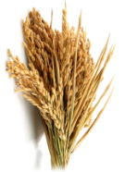







POTENSIAL BUSINESS BUMR
COMMODITY
 | RICE | CORN | COFFEE | COCOA | PALM OIL | RUBBER | TEA | SUGAR CANE
TOTAL AREA (hectares) | 14.11 mio | 3.8 mio | 1,233,294 | 1,722,315 | 11,672,861 | 3,656,057 | 118,100 | 482,233
Small holders area |  |  | 1,185,369 | 1,680,092 | 4,763,797 | 3,098,861 | 52,448 | 290,983
PRODUCTION (ton) | 75.4 mio | 19.6 mio | 667,655 | 760,429 | 33,500,691 | 3,231,825 | 154,688 | 2,715,883
Small holders production |  |  | 634,477 | 730,172 | 11,267,161 | 2,617,113 | 50,692 | 1,703,594
BUSINESS VALUE (USD)
Small holders business value |  |  | USD 1,767 B | USD 2,742 B | USD 6,614 B | USD 5,093 B | USD 99,8 M | USD 212 M
Rp 20 T | Rp 9,2 T | Rp 23 T | Rp 35,6 T | Rp 86 T | Rp 66,2 T | Rp 1,3 T | Rp 2,76 T
96%
98%
41%
85%
44%
60%

Slide 8
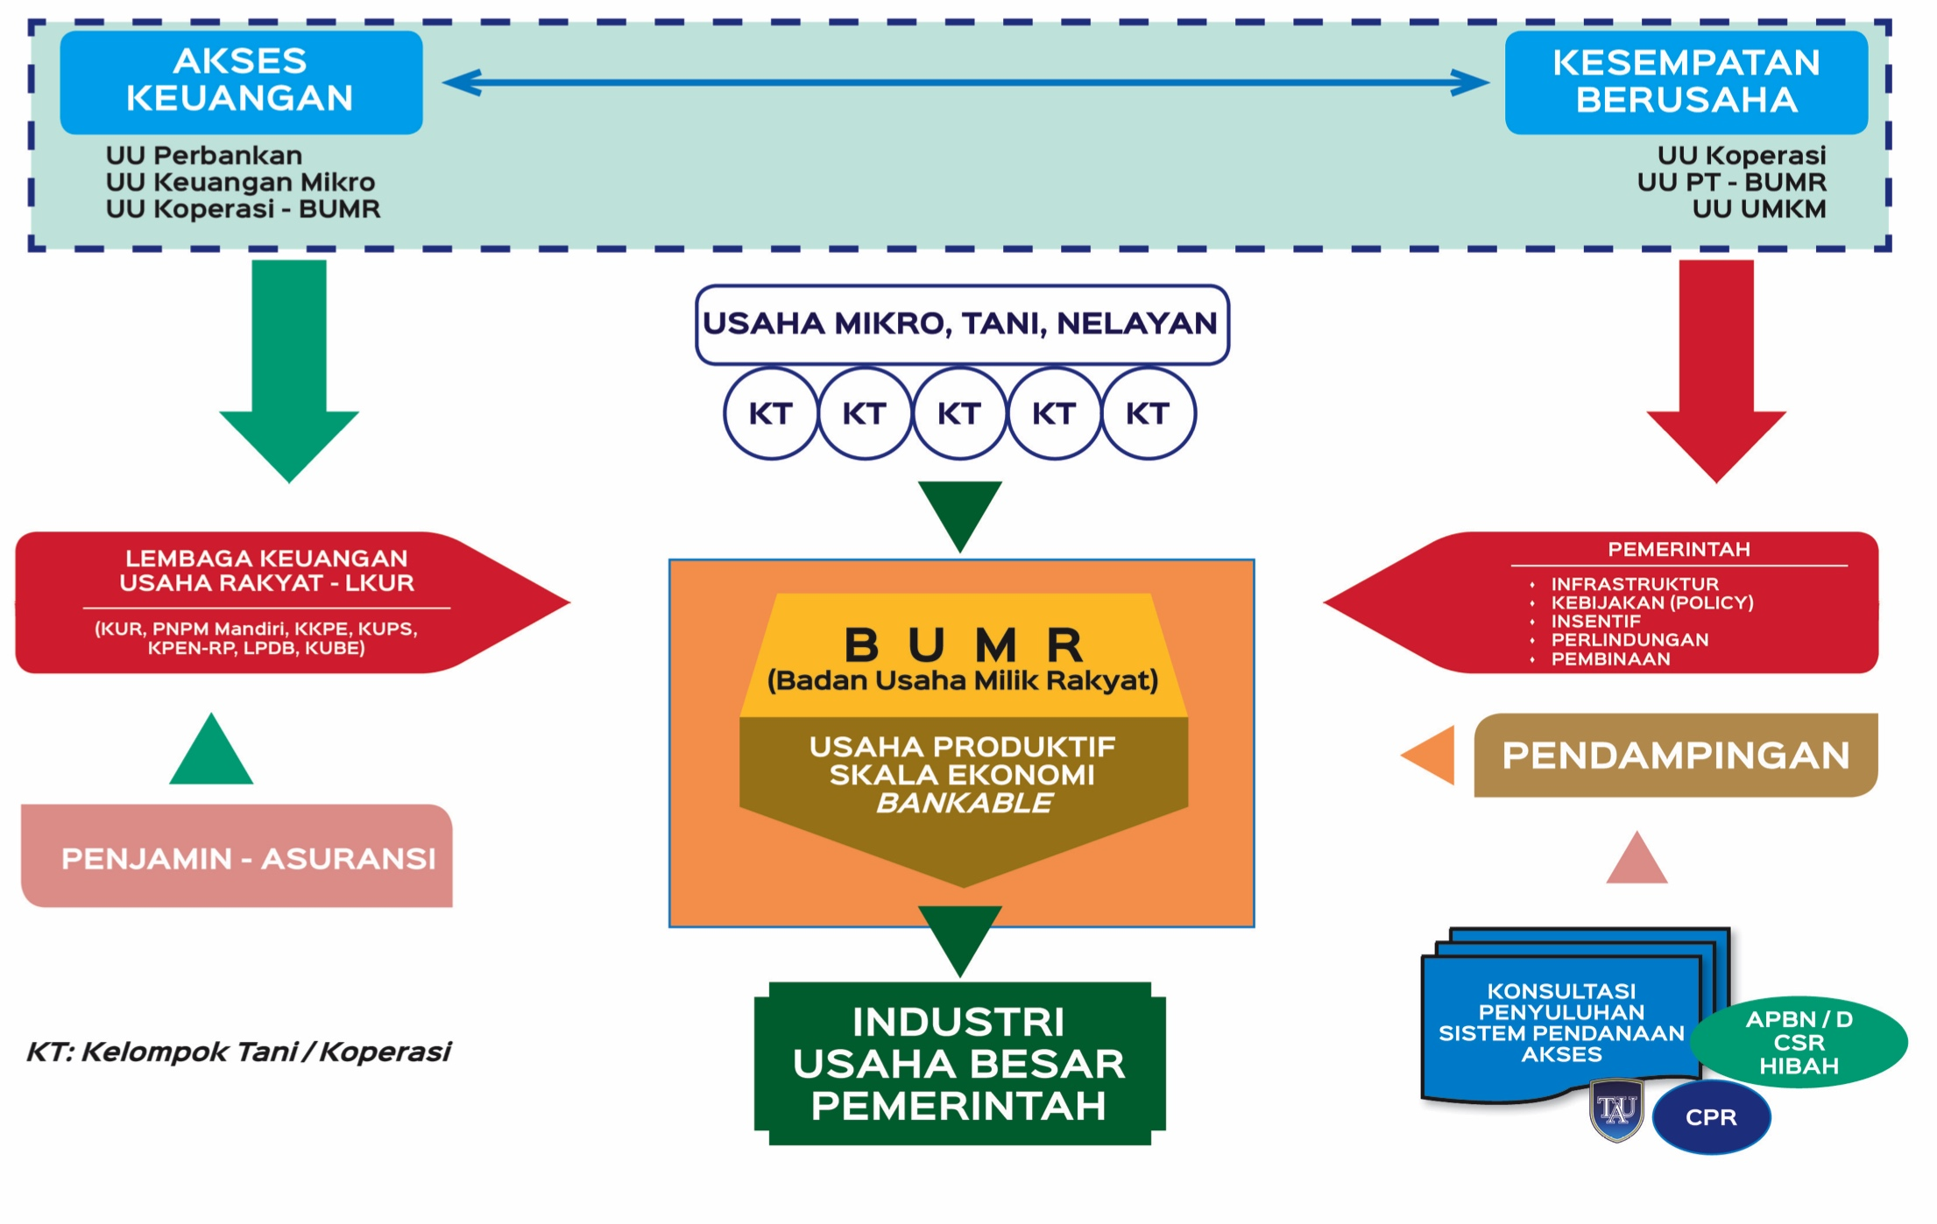
LEMBAGA EKONOMI DAN LKUR INKLUSIF
8

Slide 9
BUMR MELAHIRKAN KESEJAHTERAAN SOSIAL
Pertumbuhan (pro growth) from the bottom of the pyramid.
Pengentasan Kemiskinan (pro poor)
Penciptaan Lapangan Kerja (pro job)
Pemerataan dan Kesejahteraan (equity and equality)
Stabilitas Ketahanan Pangan dan Energi
Peningkatan Daya Saing – cost effective and high quality product – MEA
Stabilitasi Harga & Pengendalian Inflasi
Penguatan Nilai Rupiah & Peningkatan Devisa
Mengatasi Kesenjangan, Urbanisasi dan Insecurity

Slide 10

LEADERSHIP WISDOM

